Slide 1
Jožef Stefan Institute (JSI)
Knowledge in motion, a future in the making

Slide 2
Jožef Stefan Institute (JSI)
Knowledge in motion, a future in the making

Slide 3
Jožef Stefan Institute (JSI)
Knowledge in motion, a future in the making

Slide 4
Jožef Stefan Institute (JSI)
Knowledge in motion, a future in the making

Slide 5
Jožef Stefan Institute (JSI)
Knowledge in motion, a future in the making

Slide 6
Jožef Stefan Institute (JSI)
Knowledge in motion, a future in the making

Slide 7
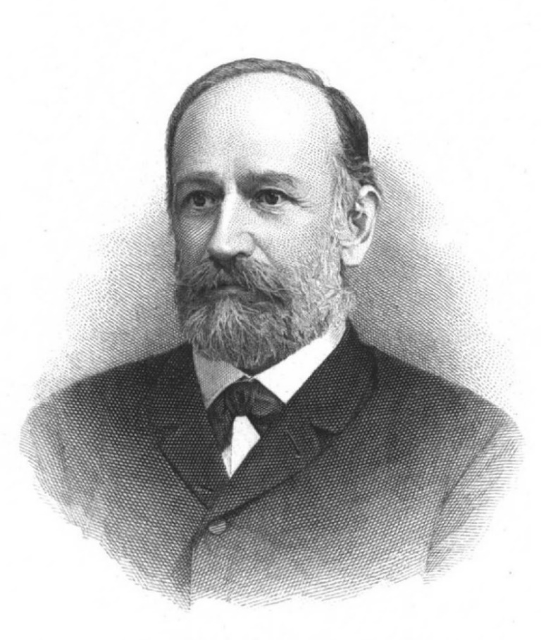
Name of the Institute
The Jožef Stefan Institute is named after Jožef Stefan, a notable physicist and the only Slovenian to have a physical law named in his honor – the Stefan–Boltzmann law of blackbody radiation.
Jožef Stefan
1835–1893

Slide 8
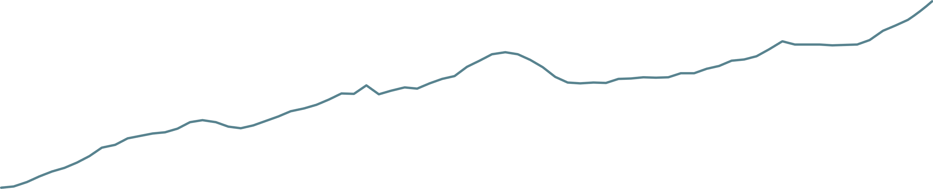
History
Institute milestones and growth in the number of employees
7
335
443
420
749
809
770
961
1087
1306
1949
1959
1966
69
“Jožef Stefan”
Institute
1985
1992
2004
2012
2020
2026
Year of establishment
Jožef Stefan
Nuclear Institute
TRIGA
Reactor
Project for 2000 new researchers
Technology Park JSI
Jožef Stefan International Postgraduate School
1st ERC project
International Research Centre on Artificial Intelligence (UNESCO)
Golden Order of Merit (TRIGA),
new tandem ion accelerator Tandetron

Slide 9
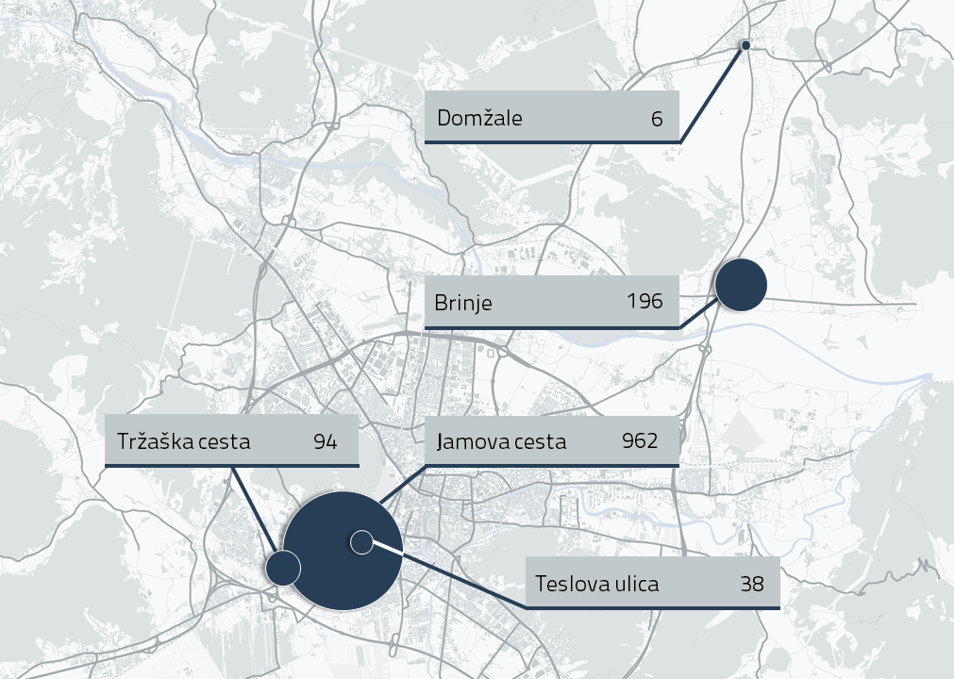
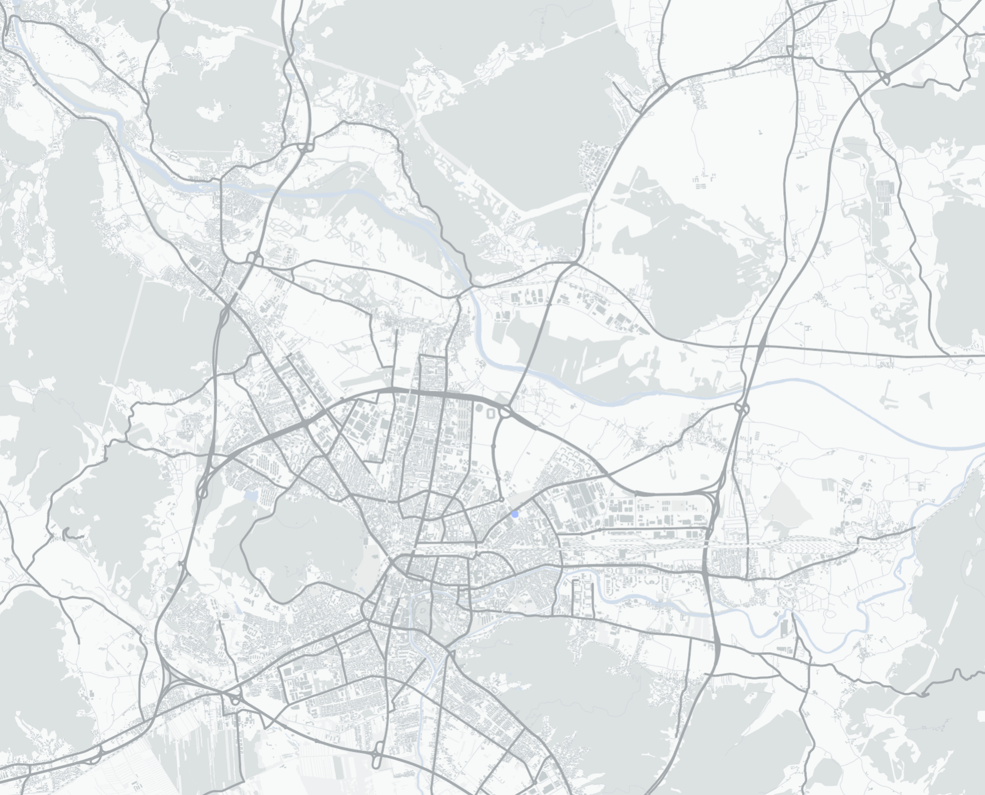

Locations and no. of employees
10
Murska Sobota
0
Planica

Slide 10
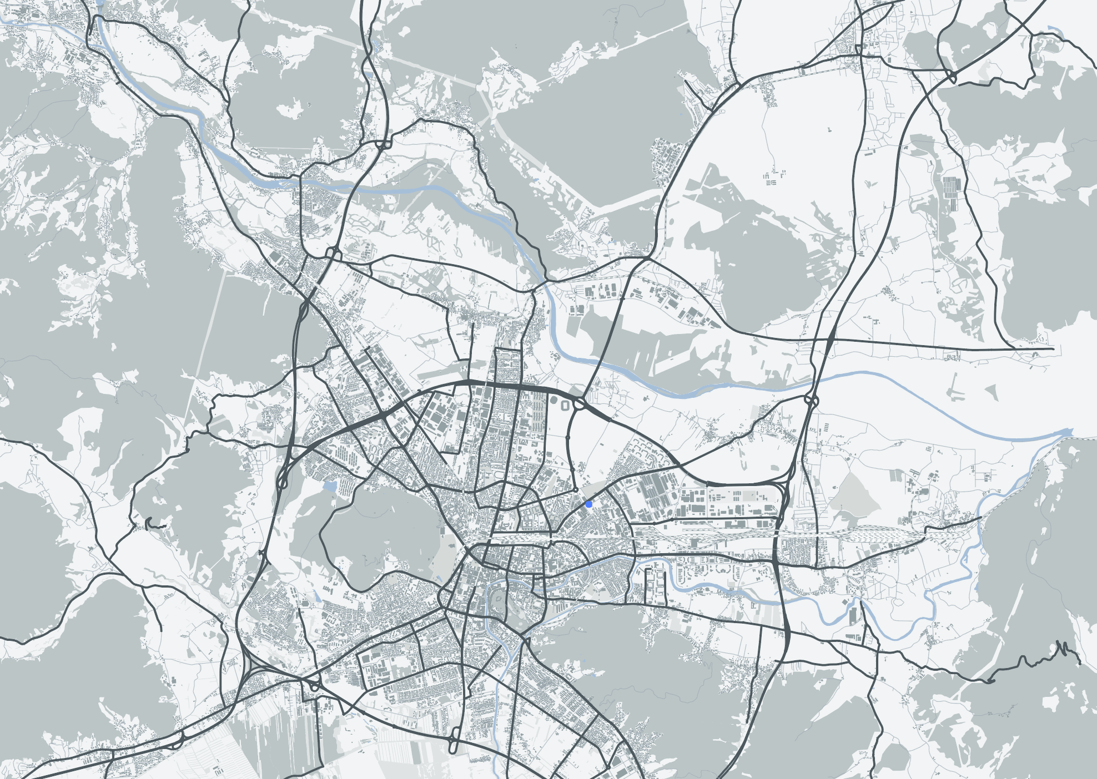
Locations
Domžale
6
Locations and number of employees
196
Brinje
962
Tržaška cesta
Jamova cesta
94
Teslova ulica
38

Slide 11

Mission
SCIENCE FOR SUSTAINABLE PROGRESS
We generate and consolidate state-of-the-art knowledge in natural sciences and technical sciences.
By disseminating and transferring knowledge, we help drive society‘s sustainable development, boost economic progress, foster talent, and contribute to a better overall quality of life. Our outstanding achievements in science strengthen Slovenia‘s global recognition.
MISSION

Slide 12
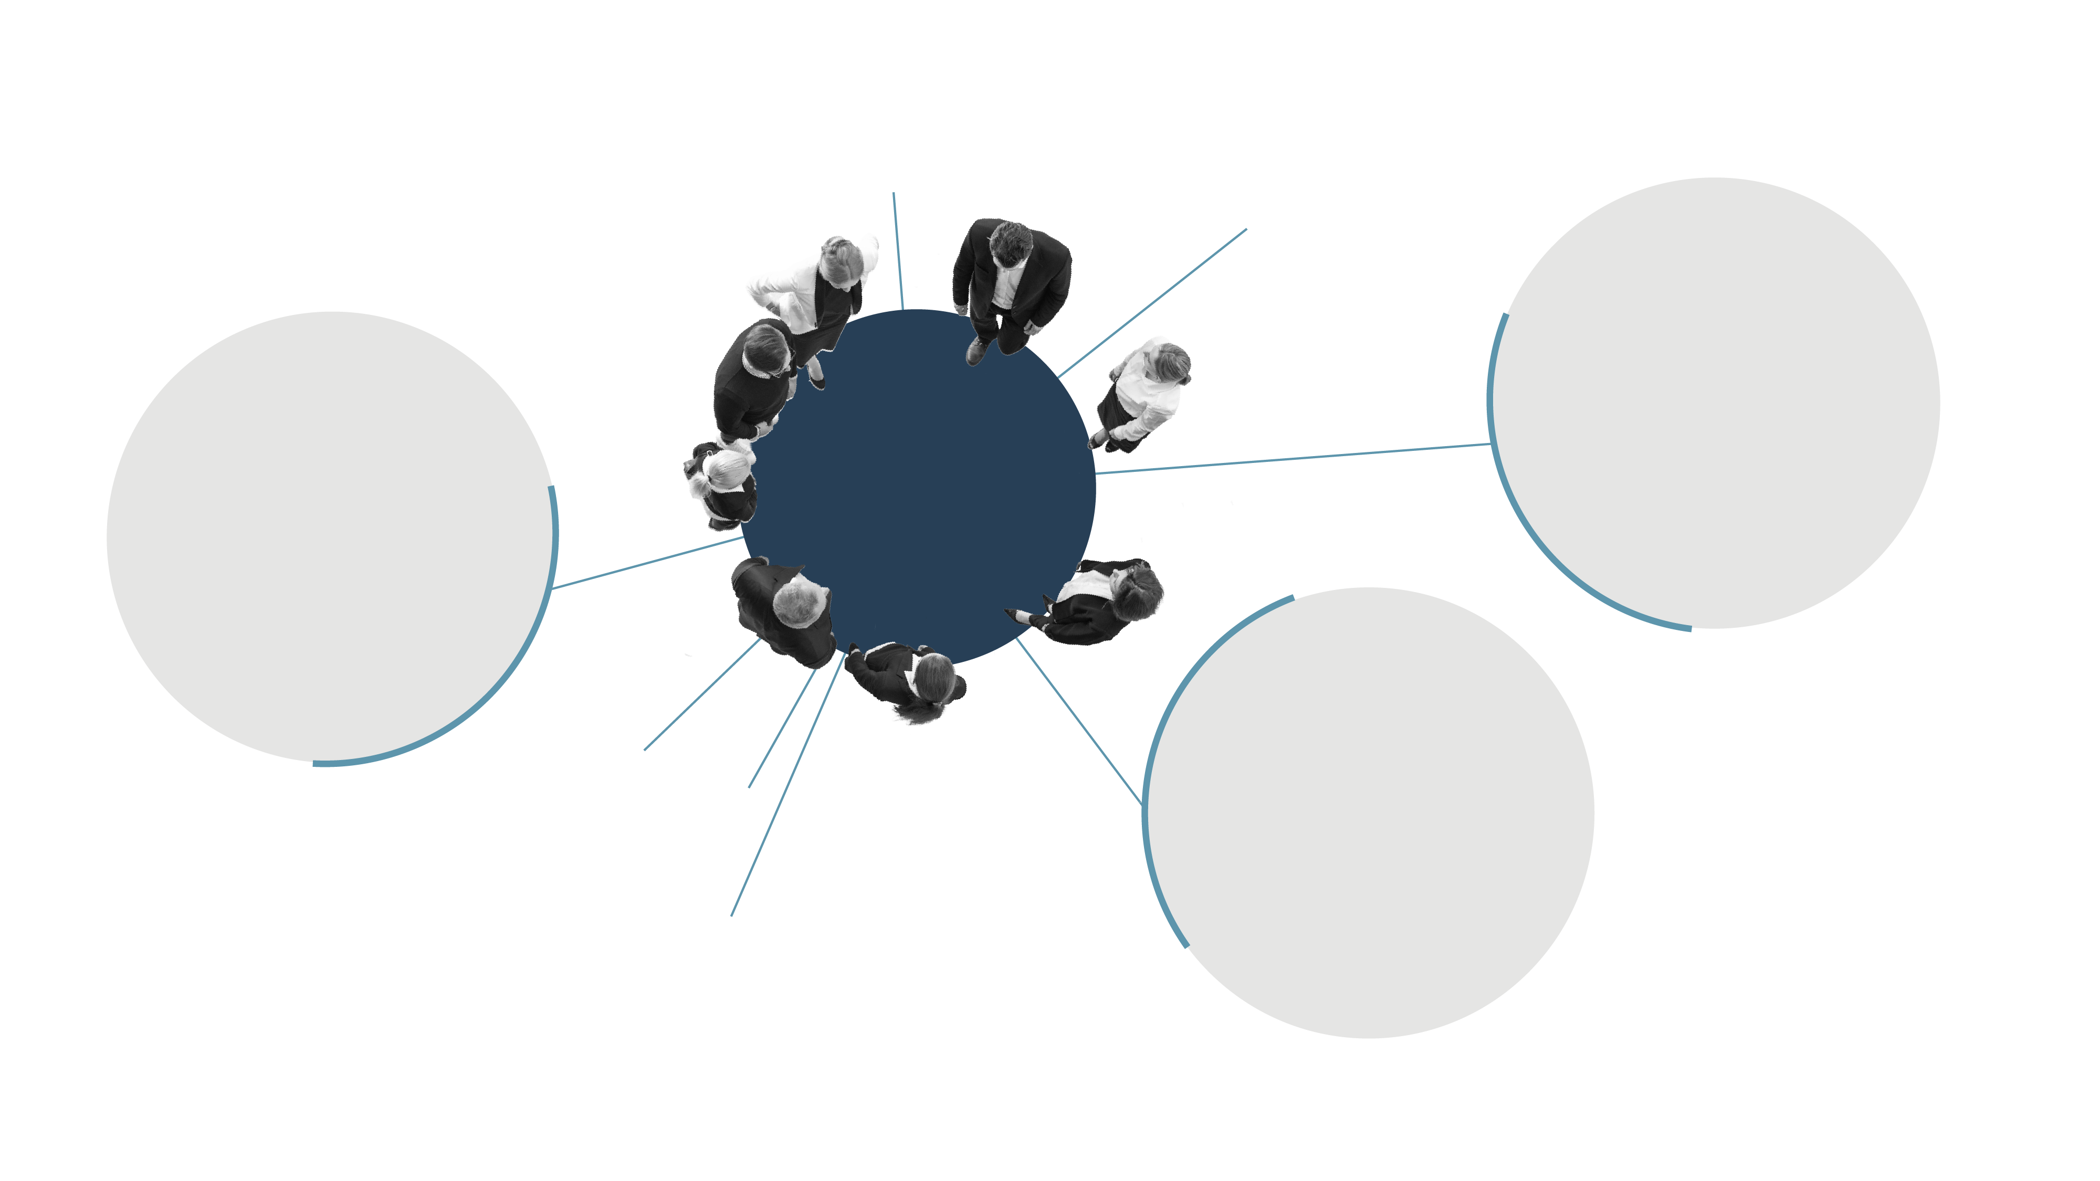
Values
SOCIAL CONTEX
Openness and relevance
Knowledge propelling the right solutions
SCIENTIFIC CONTEXT
Sustainability mindset
Good for people, good for the planet
VALUES
Research excellence
Always better
Independence and integrity
Trusted science
JSI COMMUNITY
The freedom of creation
Curiosity drives new knowledge
The power of collaboration
A fusion of ideas for accelerated progress

Slide 13

Vision
GUIDING VISION
We are a global hub for interdisciplinary research and breakthrough technologies in natural sciences and technical sciences.
Guided by our curiosity, openness, using advanced research approaches, and by applying science to economic and social challenges, we co-create sustainable solutions. We contribute to a resilient future that is rich in new knowledge and talent, healthy for people, in harmony with nature, and safe for all.
CUTTING-EDGE SCIENCE
AT THE INTERSECTION
OF DISCOVERY AND INNOVATION
VISION
SCIENTIFIC CONTEX
SOCIAL CONTEX
ORGANIZATION, CULTURE, AND STAFF
Global hub for cutting-edge sciences
We co-create groundbreaking solutions in the fields of clean energy, advanced materials, quantum and smart systems, and artificial intelligence, with a special emphasis on their impact on the environment, health, and food.
Our ambition is to become a global hub for interdisciplinary research and breakthrough technologies, connecting global networks and promoting the sustainable progress of society.
Open, reliable, unifying
We are a reliable partner to educational institutions, the business community, decision-makers, and the general public.
We actively contribute to sustainable development by addressing key social challenges, fostering new generations of scientists, and transferring knowledge from global networks to Slovenia. We engage the public in dialogue about the future, help shape social orientations, and strengthen scientific culture and trust in science and innovation.
Attractive interdisciplinary community
We are creating a strong identity of an interdisciplinary, multicultural, and diverse community of scientific departments, centres, and support units that act in a harmonized, agile, and transparent manner.
Our vision is to create a contemporary, creative, inclusive, and safe environment that promotes collaboration, enables cutting-edge research and development opportunities for all employees. Together we create a better JSI every day, making it a place where employees enjoy coming to work and that attracts the best young talents from Slovenia and the world.
13

Slide 14
Jožef Stefan Institute
Knowledge in motion, a future in the making
Mission
SCIENCE FOR SUSTAINABLE PROGRESS
We generate and consolidate state-of-the-art knowledge in natural sciences and technical sciences.
By disseminating and transferring knowledge, we help drive society‘s sustainable development, boost economic progress, foster talent, and contribute to a better overall quality of life. Our outstanding achievements in science strengthen Slovenia‘s global recognition.
Values
Research excellence
Always better
Independence and integrity
Trusted science
The freedom of creation
Curiosity drives new knowledge
The power of collaboration
A fusion of ideas for accelerated progress
Openness and relevance
Knowledge propelling the right solutions
Sustainability mindset
Good for people, good for the planet
Vision
CUTTING-EDGE SCIENCE AT THE INTERSECTION OF DISCOVERY AND INNOVATION
We are a global hub for interdisciplinary research and breakthrough technologies in natural sciences and technical sciences.
Guided by our curiosity, openness, using advanced research approaches, and by applying science to economic and social challenges, we co-create sustainable solutions. We contribute to a resilient future that is rich in new knowledge and talent, healthy for people, in harmony with nature, and safe for all.
VISION
14

Slide 15
The Institute in numbers
Data on 31. 12. 2025
Data for 2025
Data for 2000–2025
Since the establishment
of the ERC (2012)
1,306
employees
250
faculty members lecturing at ->
49
various higher-education institutions
877
young researchers
15
ERC projects
906
researchers
1,234
published scientific articles
46
ongoing research programmes
126
awards
924
completed doctoral theses
96
M€ of realised revenue
705
ongoing projects
66,404
citations
270
inventions
21,600+
visitors
3,182
media releases
336
patent applications

Slide 16
Staff
Total
1,306
employees
Number of employees by gender and area of activity
39 %
female
31 %
support staff
61 %
male
69 %
researchers

Slide 17
Staff
Total
906
researchers
Number of researchers by country of origin
23 %
international staff from
45
different countries
77 %
local staff

Slide 18
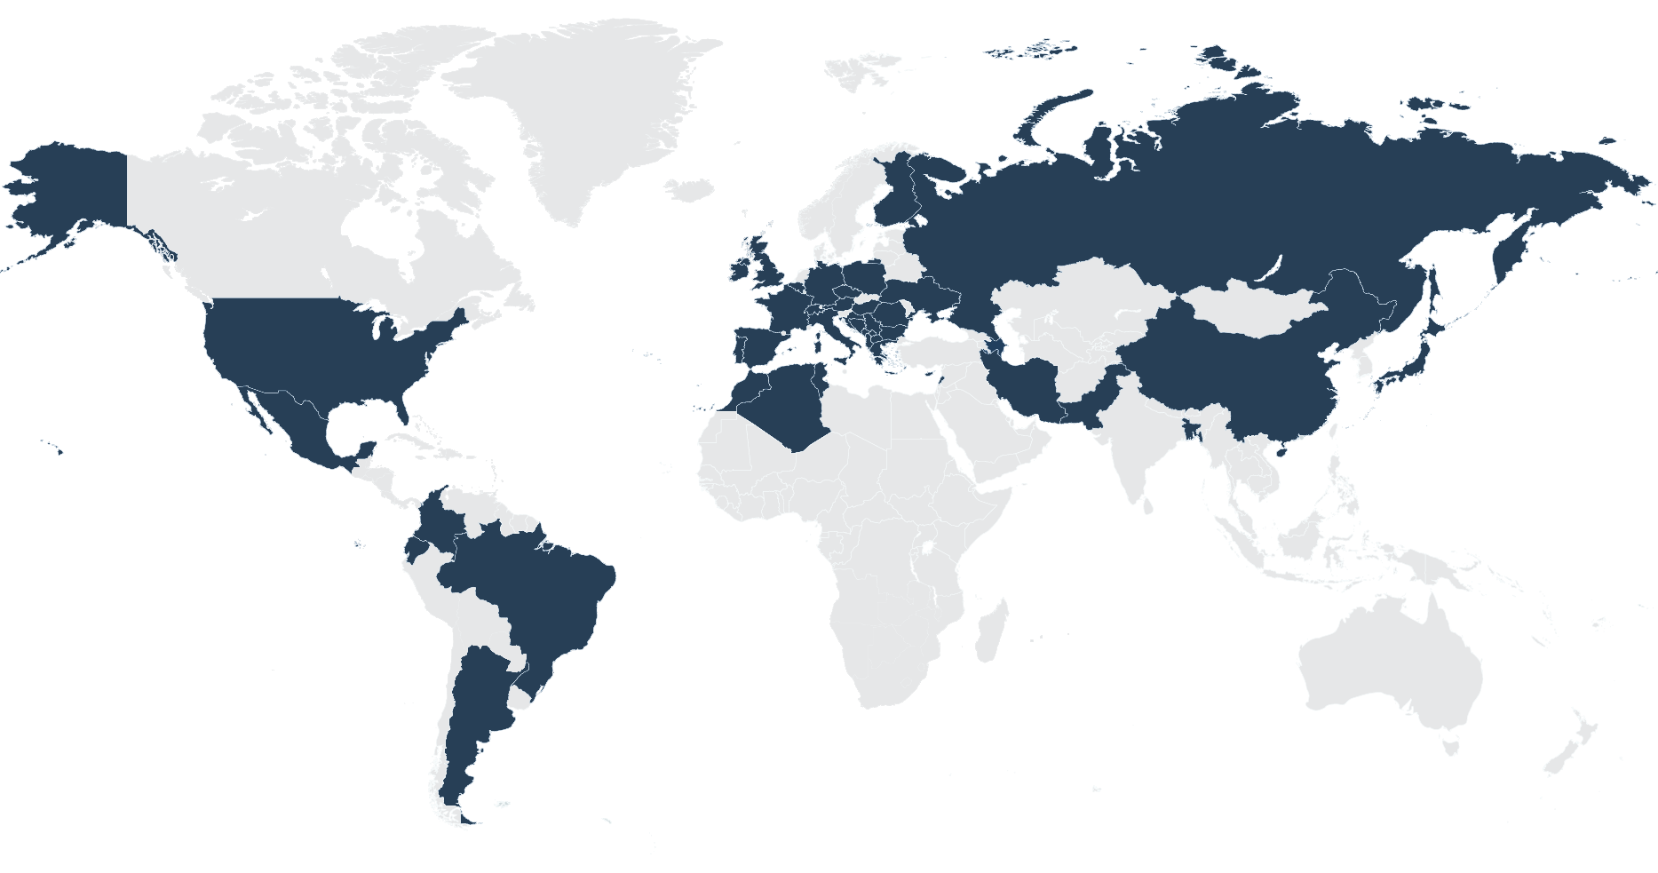
International staff
Number of researchers by country of origin
Croatia
India
Serbia
Italy
North Macedonia
Ukraine
Greece
Russian Federation
France
United Kingdom
China
Pakistan
Iran
Germany
United States
BIH
Brazil
Japan
Kosovo
Hungary
Netherlands
Poland
Romania
Spain
Austria
Czech Republic
Montenegro
Ireland
Mexico
Albania
Algeria
Argentina
Azerbaijan
Bangladesh
Belgium
Bulgaria
Cyprus
Ecuador
Finland
Colombia
Lebanon
Morocco
Portugal
Switzerland
Tunisia
Notes:
DONE!

Slide 19
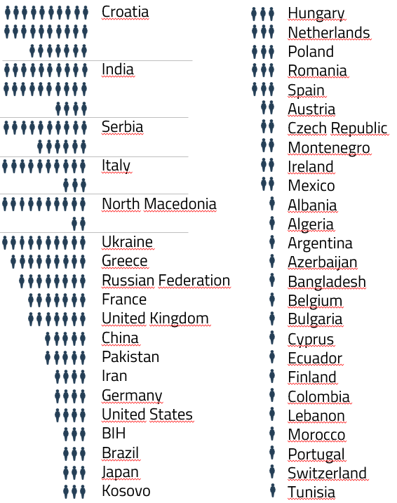
23 % international staff
Total
906
researchers
Researches from 46 different countries
23 %
abroad
77 %
Slovenija
Notes:
DONE!

Slide 20
Main areas of research
JSI departments divided into areas
Electronics and Information Technologies
Physics, nuclear engineering and energy
Chemistry, biochemistry, materials and environment
Automation, biocybernetics and robotics
Systems and control
Artificial intelligence
Open systems and networks
Communication systems
Computer systems
Knowledge technologies
Intelligent systems
Theoretical physics
Low and medium energy physics
Thin films and surfaces
Surface technology
Solid State Physics
Gas electronics
Complex matter
Reactor physics
Experimental particle physics
Reactor technology
Biochemistry, molecular and structural biology
Molecular and Biomedical Sciences
Biotechnology
Inorganic chemistry and technology
Physical and organic chemistry
Electronic ceramics
Nanostructured materials
Synthesis of materials
Advanced materials
Environmental sciences
Extreme Conditions
Chemistry Laboratory
8
departments
10
departments
11
departments

Slide 21


Main areas of research
Total
906
researchers
Number of researchers by scientific fields
(14 female researchers and 30 researchers are employed in centres and technical services)
Electronics and Information Technologies
Physics, nuclear engineering and energy
Chemistry, biochemistry, materials and environment
168
175
4
277
78
136
146
49
79
male
female
male
female
male
female

Slide 22

Publication of JSI articles in top scientific journals
Total
1,234
publications
Elsevier CiteScore
70 %
39 %
19 %
4 %
articles in
the top 25% of scientific journals.
articles in
the top 10% of scientific journals.
articles in
the top 5% of scientific journals.
articles in
the top 1% of scientific journals.

Slide 23


Publication of JSI articles in top scientific journals
Total
66,404
citations
Total
1,068
publications
Web of Science
»
»
66,404
716,071
1,068
citations of all JSI articles
citations of all JSI articles
Number of published JSI articles
Data for 2000–2025
Data for 2025

Slide 24
Projects
Total
705
projects
Number of all projects in 2025
233
159
160
153
projects financed by the national agency: ARIS
projects financed by different European Union schemes
market projects:
domestic
market projects:
international

Slide 25

The Institute and the
European Research Council (ERC)
Total
15
ERC projects
2012
D. Mihailović ERC-2012-AdG TRAJECTORY
D. Mihailović ERC-2017-PoC Umem4QC
M. Humar ERC-2019-StG Cell-Lasers P. Križan ERC-2019-AdG FAIME I. Muševič ERC-2019-AdG LOGOS
M. Lozinšek ERC-2020-StG HiPeR-F
P. Križan ERC-2022-PoC CherPET Z. Lenarčič ERC-2022-StG DrumS
L. Vidmar ERC-2023-CoG Boundary D. Mihailović ERC-2023-AdG HIMMS
M. Humar ERC-2024-POC EdibleLasers
M. Humar ERC-2024-CoG SoftQuanta
A. Tykhonov ERC-2024-CoG PeVGALAXY
D. Golež ERC-2025-CoG META-QMS
D. Mihailović ERC-2026-PoC FEMTOGAPENGINE
2017
2019
2020
2022
2023
2024
2025
The JSI is proud of all
its ERC project grantees
2026
161
251
Notes:
V letu 2025 bodo trenutno še: - EdibleLasers (F5), SoftQuanta (F5) in PeVGALAXY (F9).

Slide 26

Research programmes
Total
46
research programmes
Number of programmes by policy area in 2025
Electronics and Information Technologies
Physics, nuclear engineering and energy
Chemistry, biochemistry, materials and environment
11
JSI
participant
35
JSI coordinators
7
1
17
5
11
5

Slide 27
Programme revenues
Total
23.492
M€
Revenues from programmes by topic in 2025
Electronics and Information Technologies
Physics, nuclear engineering and energy
Chemistry, biochemistry, materials and environment
2.025
M€ JSI partner
21.467
M€ JSI
coordinator
3.844
0.505
9.986
0.615
7.637
0.905

Slide 28
Young researchers
Total
877
young researchers
Number of young researchers covered by ARIS funding in the period 2000–2025 by year
50
40
30
20
10
2000
2005
2010
2015
2020
2025

Slide 29
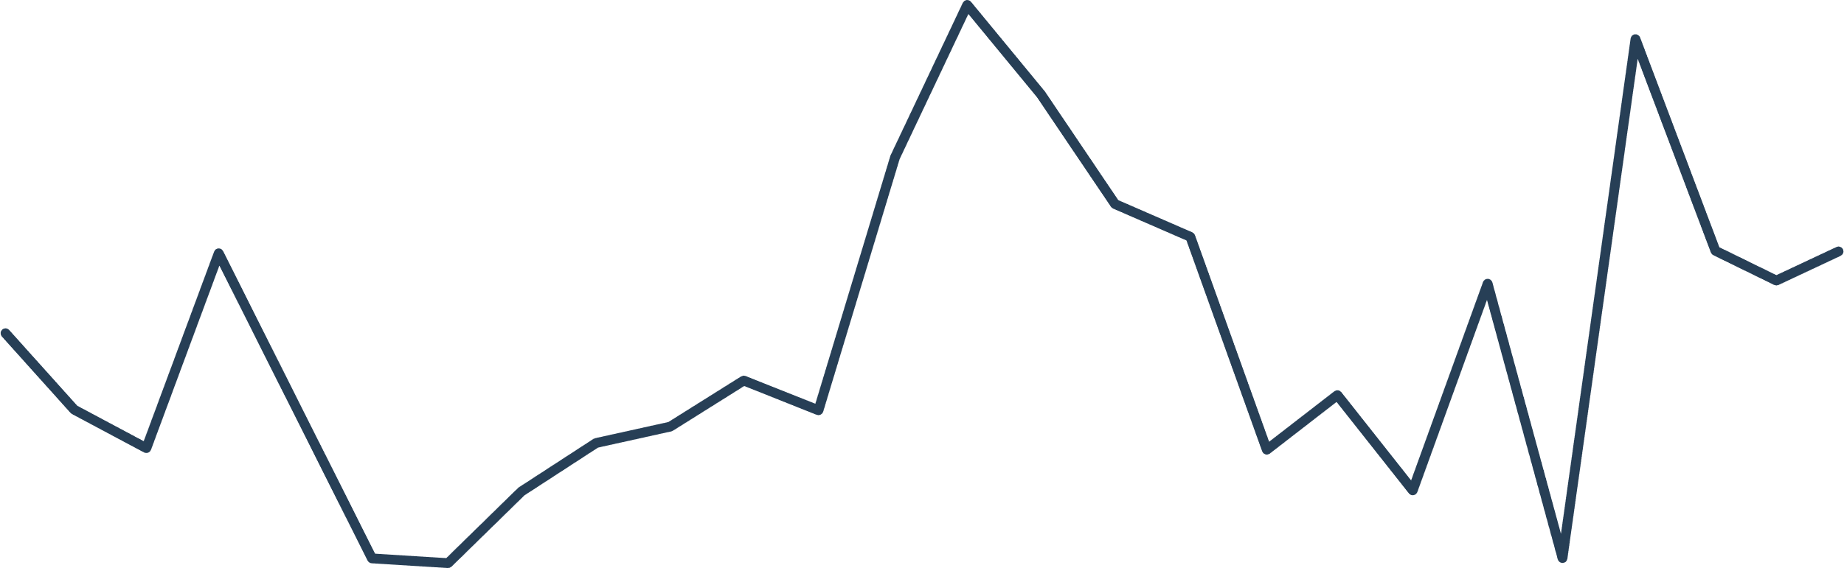
Doctoral theses
Total
924
Doctoral theses
Number of doctorates with mentors from the JSI
60
50
40
30
20
10
2000
2005
2010
2015
2020
2025

Slide 30

Awards
Total
126
awards
Number of Zois, Puh Awards and Ambassadors of Science
50
Zois prizes
5
Ambassadors of science
39
Zois awards
27
Puh
prizes
5
Puh
awards

Slide 31
Inventions
Total
270
invention disclosures
Number of invention disclosures
20
15
10
5
2000
2005
2010
2015
2020
2025

Slide 32
Patents
Total
336
patent applications
Number of patent applications
30
25
20
15
135
201
10
SLO
Abroad
5
2000
2005
2010
2015
2020
2025

Slide 33
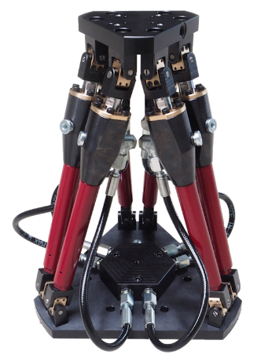
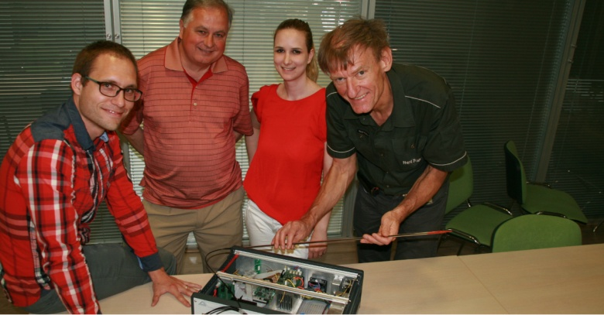
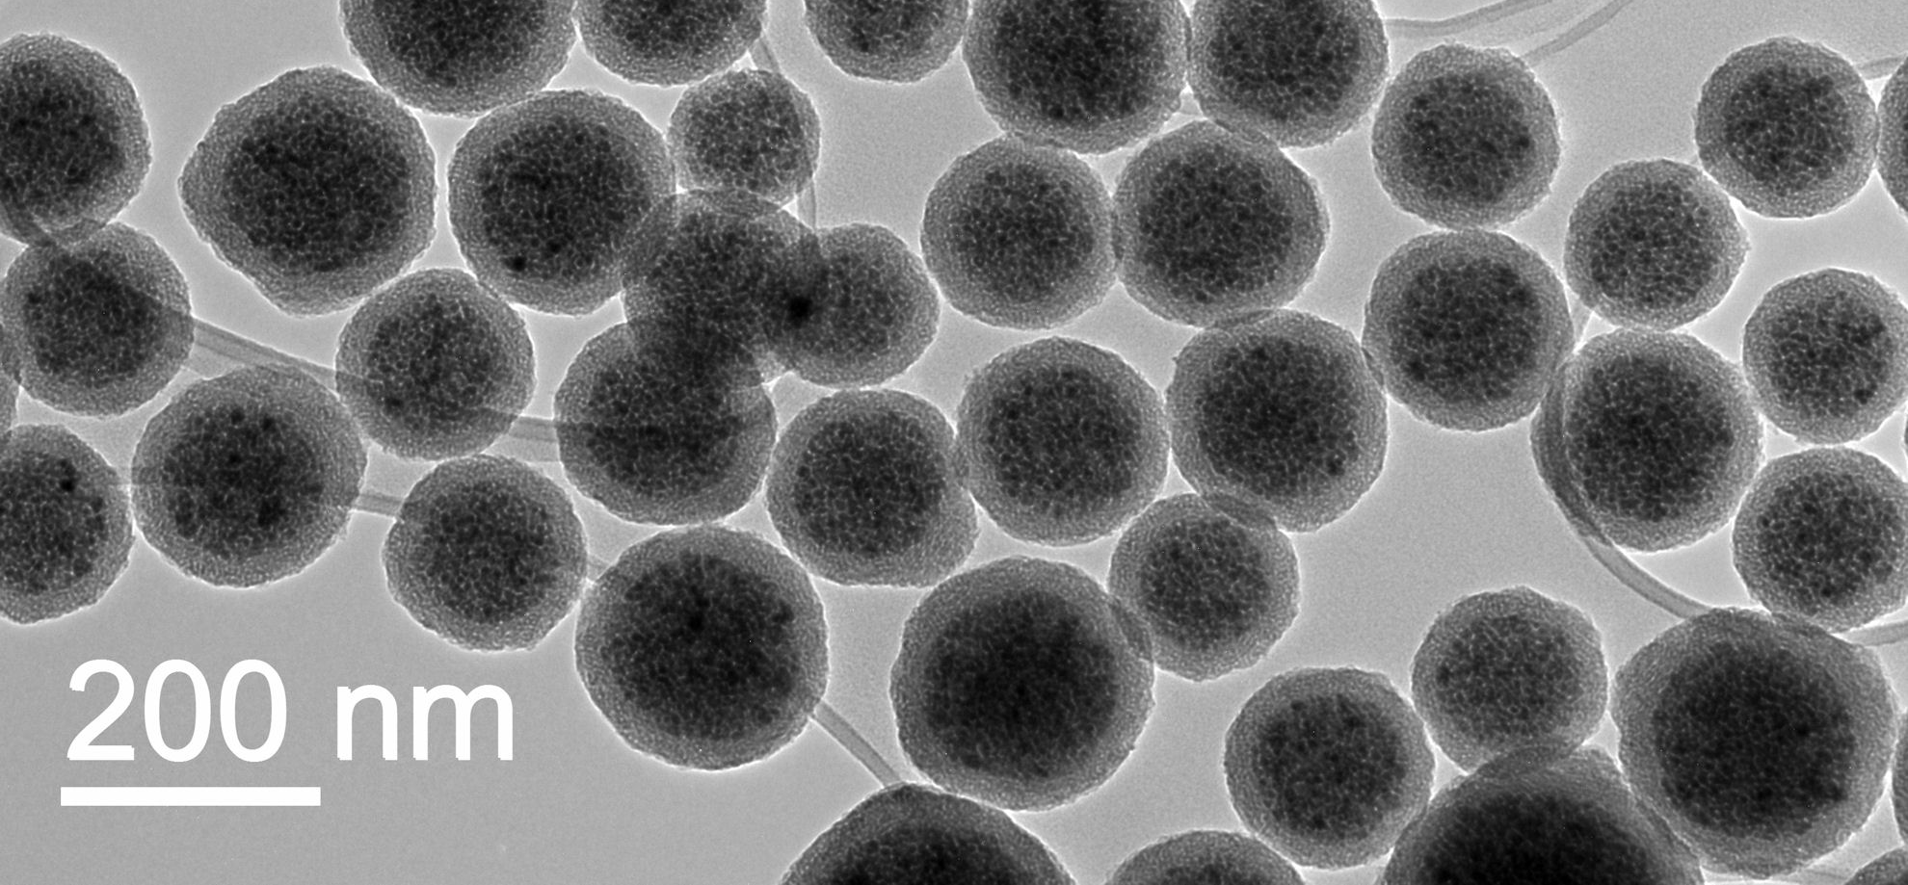

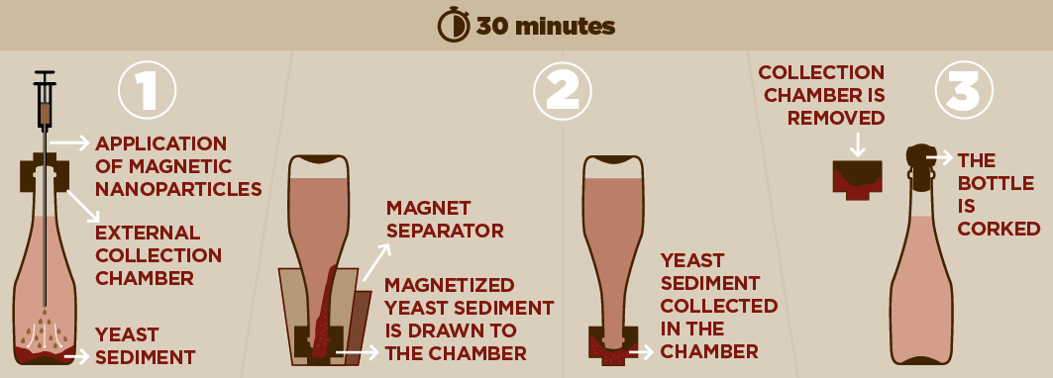
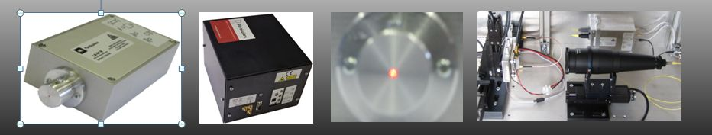
JSI‘s selected spin-outs
Plasmadis
Plasma reactor optimization by Laser Optic Catalytic Sensor (LOCS)
http://www.plasmadis.com/
Nanos Scientificae
Nanotechnology solutions based on magnetic nanoparticle clusters – magnetic nanobeads – iNANOvative™ platform.
http://www.nanos-sci.com/
Atom Quantum Labs
Designing cold neutral atoms Quantum Computers.
https://atomql.com/
FlexHex
Robotic hexapods for the automotive industry
http://flexhex-robot.com/
InoVine
Rapid separation of yeast sediment from sparkling wine.
http://www.ino-vine.com/
Infinite
Toxicity testing of materialsNovel sensorial cellular devices for personal diagnostics. Science-based animal alternatives.
http://infinite-biotech.com/
Particulars
Transient Current Technique (TCT) apparatus for studies of various semiconductor devices and materials.
http://particulars.si/
Genuine Technologies
Synthetic bioceramic powder-like material based on calcium tri-silicate with high bioactivity.
https://www.gen-tech.si/

Slide 34


Comparison with the rest of the world
Jožef Stefan Institute (JSI) // Max Planck Institute (MPG) // French National Centre for Scientific Research (CNRS)
 |  | population | Number of employees | Number of employees as % of population
JSI | Slovenia | 2.13 milion | 1,306 | 0.06 %
MPG | Germany | 84.08 milion | 26,000 | 0.03 %
CNRS | France | 69.08 milion | 35,000 | 0.05 %
Employees
 |  | Annual revenue | Annual income per employee
JSI | Slovenia | 96 M€ | 73,439 €
MPG | Germany | 2,698 M€ | 103,769 €
CNRS | France | 3,974 M€ | 113,543 €
Revenue

Slide 35
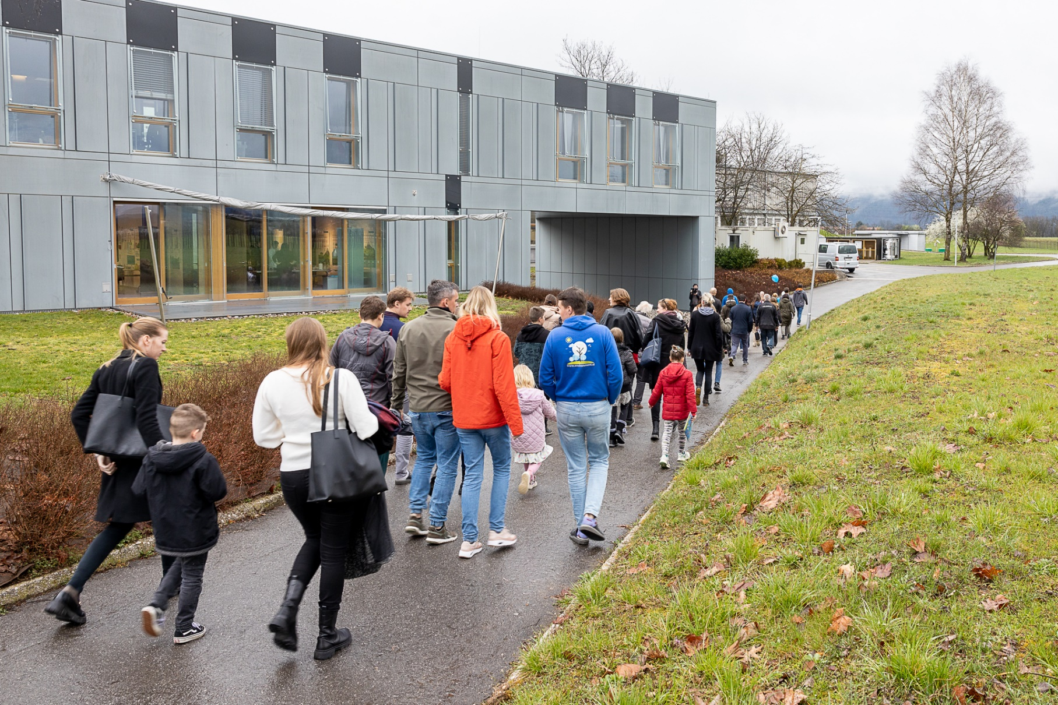
Public cooperation
Total of more than
21,600+
visitors
Number of visitors to JSI events organised for different groups and number of visitors to the Nuclear Technology Training Centre
Events
Colloquia
Gallery
School visits
Days of Jožef Stefan
Open Day
1,200
9,500
1,010
1,000
2,000
Nuclear Technology Training Centre
6,940
Notes:
ICJT je rešeno

Slide 36
Appearances in the media
Total
3,182
media releases
Incidences of the Jožef Stefan Institute and the director
appearing in print and online media
20 %
posts in
print media
Media that wrote the most on these topics:
Authors who wrote the most on these topics:
80 %
publications in online media
gorenjskiglas.si
rtvslo.si
sta.si
telex.si
Delo
STA
Saša Senica
S. S.
Nina Slaček
A. I.

Slide 49
Thank you for your attention
Jožef Stefan Institute
Jamova cesta 39
1000 Ljubljana
Slovenia
https://www.ijs.si/

